Slide 1
Introduction to Web Design
Tseng Hin Chau
12171025

Slide 2
Overview – Background Information
The newly born music stars, Mirror, Error and Collar etc. are greatly contributing to Hong Kong local music and entertainment industries these days.
Local music industry seems to be revived.
More people are willing to encounter Cantopop, ranging from older generations to millennials.
Using a public figure Leslie Cheung (張國榮) to reintroduce Cantopop to the public from the 80s to 00s that had been sweeping through the whole city
Bringing back priceless cultural heritage to people that seems to be lost as time progresses

Slide 3
Overview – Target Audience
HongKongers
Millennials
Older generations
Anyone who is interested in Canton-pop music since 80s
Worldwide fans from different countries

Slide 4
Goals and Objectives
Using Leslie Cheung (張國榮 1956-2003, “GorGor”), a well-known celebrity to promote the lost legacy in the music and film industry in the old days.
Aims to bring home to public the music and film culture in Hong Kong during the 80s-00s.
Harnessing the power of a website to provide the audience with an intriguing rather than a mundane way to broaden their horizons.
Familiarizing themselves with a person they would have no chance to meet anymore by a variety of eye-catching descriptive graphics, audio and visual effects etc.

Slide 5
Content Structure – Site Map
Homepage
Music Life
Life as an Actor
Profile
As a Composer
In Full Bloom
Film
Recognition After Passing Away

Slide 6
Content Structure – Content Types
Texts and Graphics with Captions
Profile
Life as an Actor
Music Life (Lyrics)
Audio
Homepage
Homepage
Music Life
Life as an Actor

Slide 7
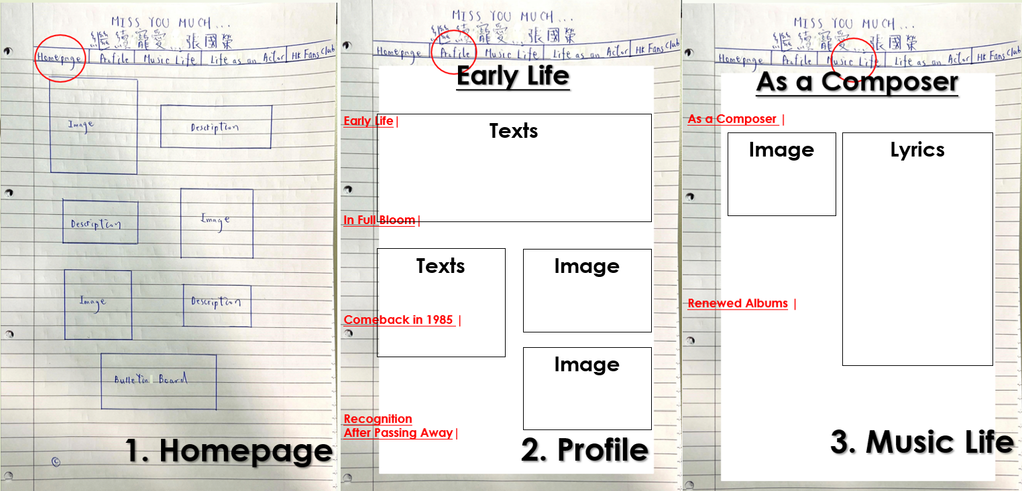
Content Structure – Storyboards I
LOGO
ICON
In Full Bloom

Slide 8
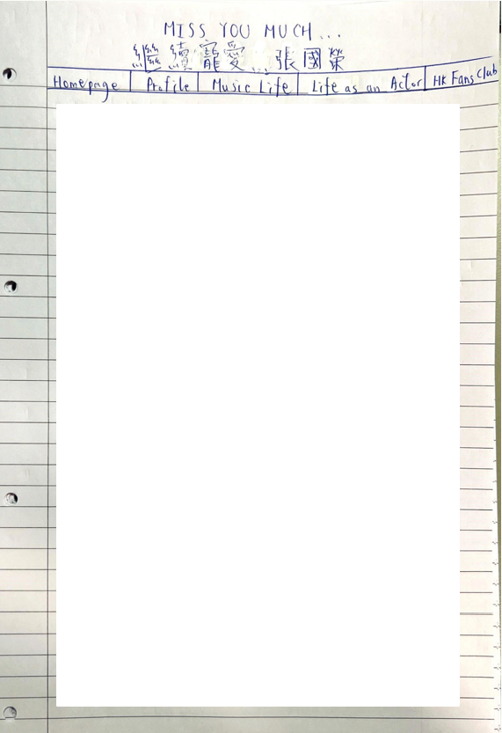
Content Structure – Storyboards II
Films
Early Drama
Early Drama |
Films |
Texts
Image
Texts
Image
Image
Texts
4. Life as an Actor

Slide 9
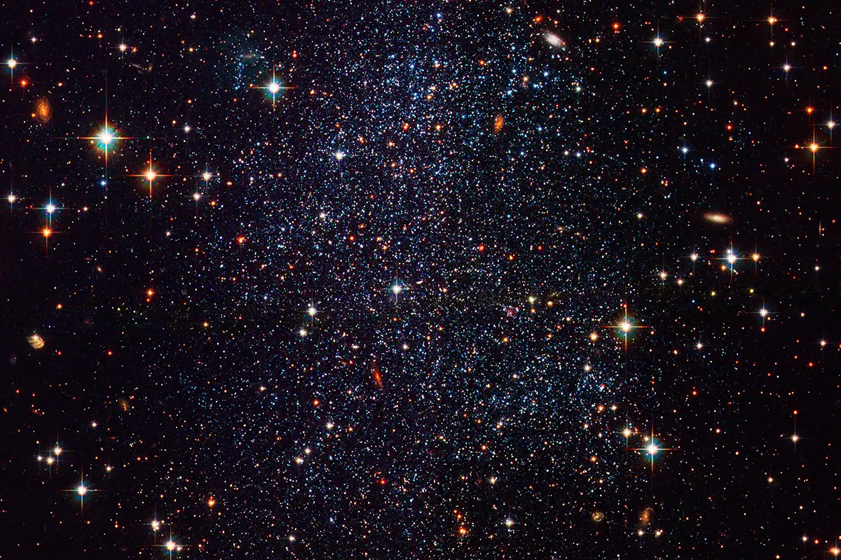
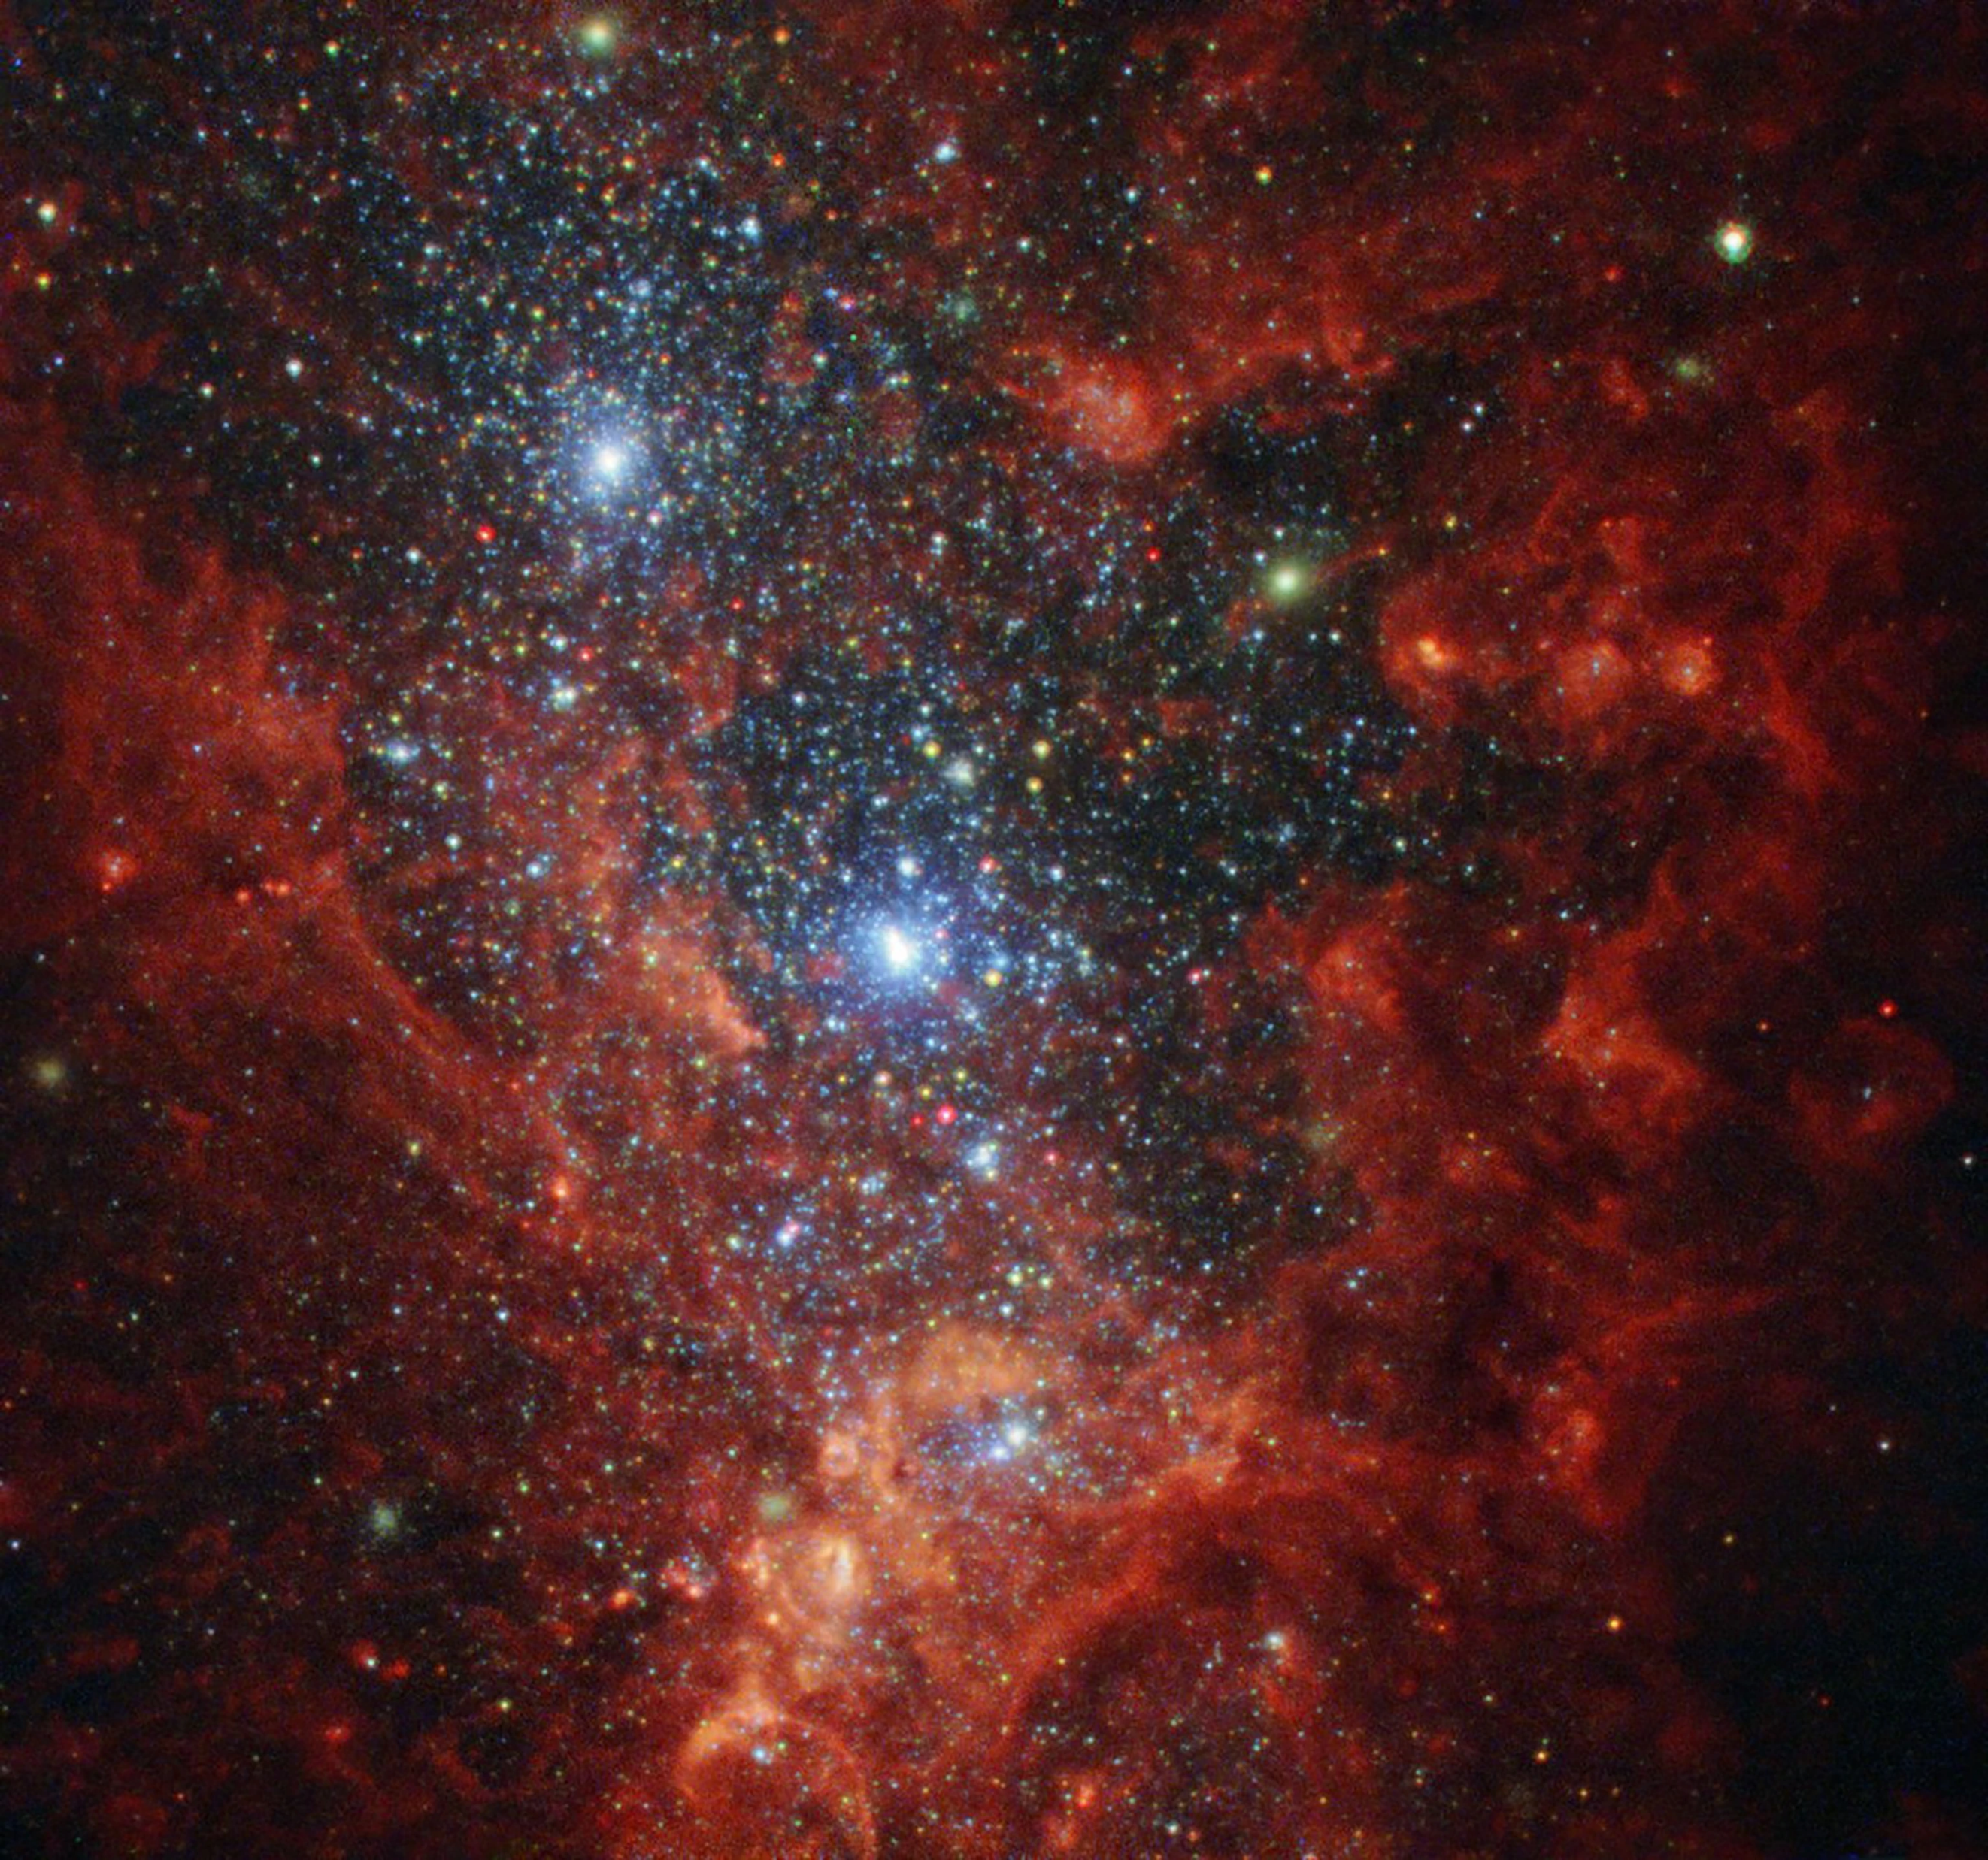
Backgrounds
Content Structure – Visual Designs
Using eye-catching night skies as backgrounds
Creating a mysterious and tranquil atmosphere
Holding attention of audience
Willing to stay longer
To have a more thorough browse of the website
Text
Implementing contrast colours to the text
Increasing the readability and user-friendliness

Slide 10
Content Structure – Accessibility/Usability
Intuitive Design ✔️
Effortless to understand the architecture and navigation
Consistent layouts for all pages
Subjective Satisfaction
✔️
Well-selected photos help holding attention
Not tedious, having audio effect besides plain text
Easy to learn how to use

Slide 11
Analysis of the competition
I. kkbox.com
II. Wikipedia
Having only lyrics and composer details
Lacking background information of songs/music
Can only read on a plain background
Boring
Informative
But too lengthy and wordy
Not worth-investing in time to browse through the website
Easily editable by the general public
Inspirations
Inspirations
Audio sound effects are added to give more zests (i.e At the Homepage and ‘Music Life’ Session)
Adding Bulletin Boards for the kind-spirited to leave comments and exchange ideas like a forum
Supplementary background information is added (i.e When/Why the song is composed)
Using an attractive background instead (i.e night skies, galaxies etc.)

Slide 12
~THE END~
Thank you!

